Slide 1
8085
Micro Processor Architecture

Slide 2
Session Objectives
Explain various types of processor architecture
Features of 8085 μProcessor
Internal architecture of 8085 microprocessor
Programmer’s model of 8085 microprocessor
8085 pin diagram & description

Slide 3
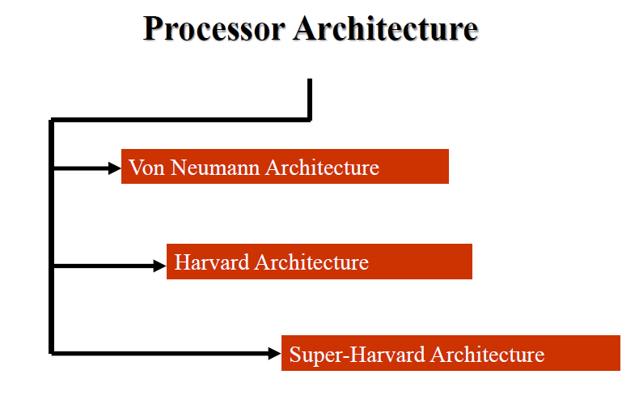

Slide 4
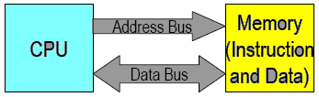
Von Neumann Architecture
Common memory for Data & program code

Slide 5
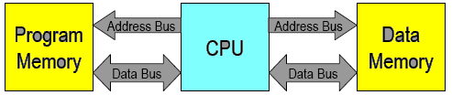
Harvard Architecture
Separate memory blocks for program (instructions) and data
–More efficient since accessing instructions and data can be done in parallel

Slide 6
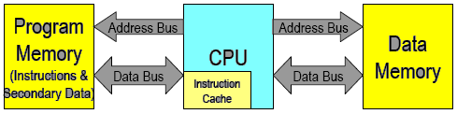
Super-Harvard Architecture (SHARC)
– Secondary data is stored in program memory to balance the load on both memory blocks

Slide 7
Features of 8085
It is an 8 bit microprocessor i.e. It can accept , process or provide 8 bit data simultaneously.
It has 16 bit address line i.e. it can access 2¹⁶ = 64 kbytes of memory.
It can operate with a 3 MHz clock frequency.
It operates on a single +5v power supply.
It supports 74 instructions with different addressing modes.
It provides five hardware interrupts: TRAP, RST 7.5, RST 6.5, RST 5.5 & INTR.
It has serial I/O control which allows the serial communication.

Slide 8
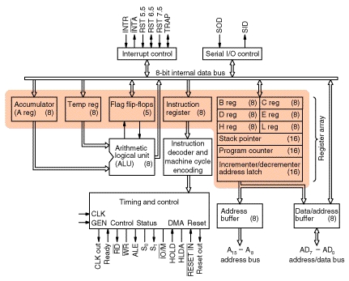

Slide 9
It consists of following functional blocks: -
Registers
ALU
Instruction decoder & Machine cycle encoder
Address buffer
Address / Data buffer
Increment / Decrement address latch
Interrupt control
Serial I/O control
Timing & control circuit

Slide 10
1. REGISTERS
The 8085 includes six registers, one accumulator, and one flag register, as shown in Figure.
In addition, it has two 16-bit registers: the stack pointer and the program counter.
The 8085 has six general-purpose registers to store 8-bit data; these are identified as B,C,D,E,H, and L as shown in the figure.

Slide 11
Classification of Registers: -
General purpose registers
Temporary registers
Temporary data register
W & Z register.
Special Purpose registers
Accumulator
Flag register
Instruction register
16 Bit registers
Program counter
Stack Pointer

Slide 12
1.1 General purpose registers
The 8085 has six general-purpose registers to store 8-bit data these are identified as B,C,D,E,H, and L. They can be combined as register pairs - BC, DE, and HL - to perform some 16-bit operations. The programmer can use these registers to store or copy data into the registers by using data copy instructions.
Also HL pair works as a memory pointer. These are also called as scratchpad registers.

Slide 13
1.2 Temporary Registers
a) Temporary data register: - The ALU has two inputs one is supplied by the accumulator & other from the temporary data register. These registers cannot be accessed by the programmer.
For eg. ADD B : - it adds contents of reg A with reg B and stores the result in reg A. In this case one input to ALU is from reg A directly but contents of reg B are first transfer to temp reg & then to the ALU.
b) W & Z Registers: - these registers are used to hold the 8 bit data during execution of some instructions, these are not accessible by the user because used by the processor internally.
for eg. During calling a subprogram , contents of Program Counter are pushed to stack & load the given address into PC. This given address is temporarily stored in W & Z.

Slide 14
1.3 Special purpose registers
Accumulator : - The accumulator is an 8-bit register that is a part of arithmetic/logic unit (ALU). This register is used to store 8-bit data and to perform arithmetic and logical operations. The result of an operation is stored in the accumulator. The accumulator is also identified as register A.
Instruction Register:- Temporary store for the current instruction of a program. Latest instruction sent here from memory prior to execution. Decoder then takes instruction and ‘decodes’ or interprets the instruction. Decoded instruction then passed to next stage.
Flag Register : - The ALU includes five flip-flops, which are set or reset after an operation according to data conditions of the result in the accumulator and other registers.

Slide 15
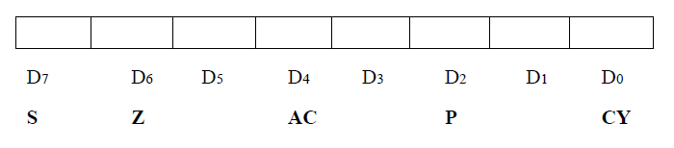
S – Sign Flag : - IF bit D7 of the result is 1, the sign flag is set, this means result is negative number.
Z – Zero flag: - It is set if the result of operation in ALU is zero.
AC – Auxiliary carry flag: - This flag is set if carry from lower nibble is generated.
P- Parity flag:- Parity is defined as the number of 1 present in the accumulator after operation. For even parity flag is set & for odd parity it is reset.
Cy – Carry flag: - This flag is set if a overflow at D7 bit is occurred, i.e carry or borrow generated.

Slide 16
1.4 Sixteen Bit registers
Program Counter (PC):- This 16-bit register deals with sequencing the execution of instructions. This register is a memory pointer. Memory locations have 16-bit addresses, and that is why this is a 16-bit register. The microprocessor uses this register to sequence the execution of the instructions. The function of the program counter is to point to the memory address from which the next byte is to be fetched. When a byte (machine code) is being fetched, the program counter is incremented by one to point to the next memory location
Stack Pointer (SP):- The stack pointer is also a 16-bit register used as a memory pointer. It points to a memory location in R/W memory, called the stack. The beginning of the stack is defined by loading 16-bit address in the stack pointer. It holds the address of most recent stack entry.

Slide 17
2. Arithmetic Logic Unit
The ALU performs the actual numerical and logic operation such as ‘add’, ‘subtract’, ‘AND’, ‘OR’, etc. Uses data from memory and from Accumulator to perform arithmetic. Always stores result of operation in Accumulator.
3. Instruction decoder
Processor first fetches the opcode from memory & store it in the instruction register. Then it is sent to instruction decoder to decode & accordingly it gives the timing & control signal which control the registers & data buffers.
4. Address Buffer
It is an 8 bit unidirectional buffer, used to drive external high order address bus (A15 – A8).

Slide 18
5. Address/ data Buffer
It is an 8 bit bidirectional buffer, used to drive multiplexed lower order address bus (A7 – A0) & data bus (D7 – D0).
6. Increment / Decrement Address Latch
This 16 bit register is used to increment or decrement the contents of program counter or stack pointer as a part of execution of instructions related to them.
7. Interrupt control
It controls the occurrence of interrupts during the normal execution of program.

Slide 19
8.Serial I/O control
In situations like data transmission, communication with external devices like CRT, cassette tape etc, data transmission is done serially. This control provides two line SID & SOD for serial communication.
9.Timing & control Circuit
Control circuit generates signals within uP to carry out the instruction, which has been decoded. In reality causes certain connections between blocks of the uP to be opened or closed, so that data goes where it is required, and so that ALU operations occur. It synchronized the operations with clock signal.

Slide 20
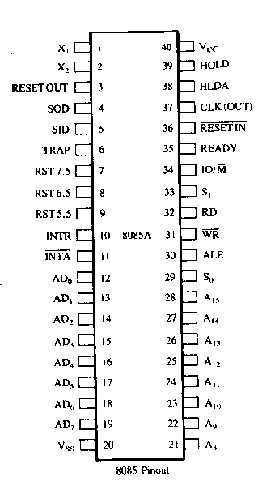
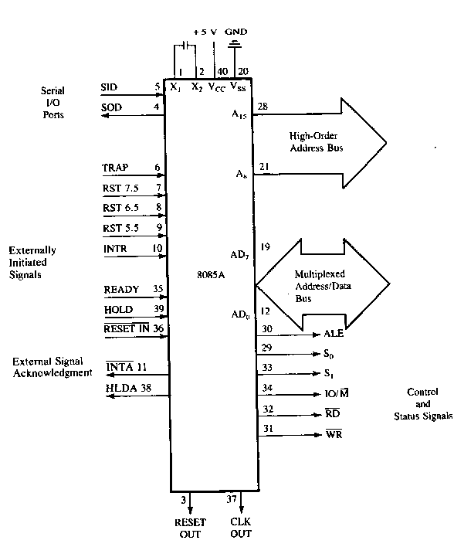

Slide 21
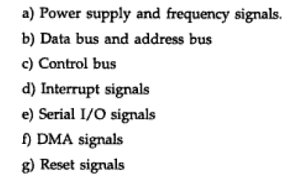
Pins of 8085 are classified in 7 categories

Slide 22
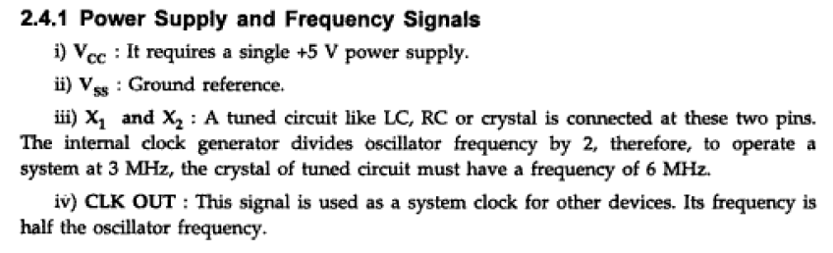
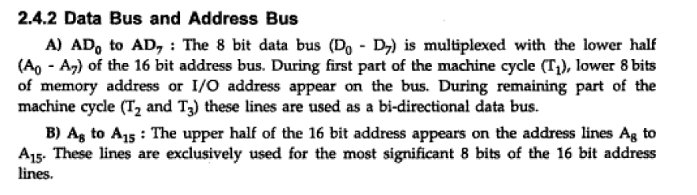

Slide 23


Slide 24
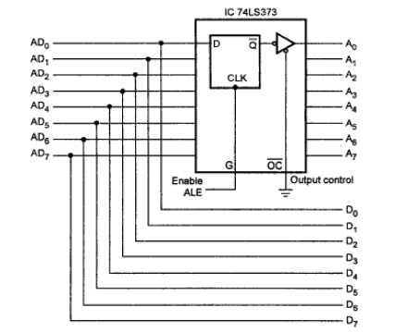
ALE : - Address Latch Enable: It occurs during the first clock cycle of a machine state and enables the address to get latched into the on chip latch of peripherals.
Detailed working of following circuit, we will see in bus organization topic .

Slide 25
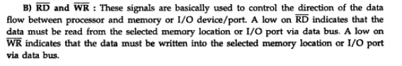
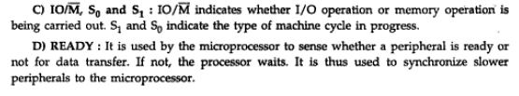
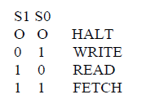

Slide 26
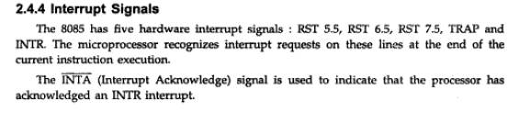
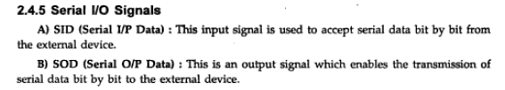
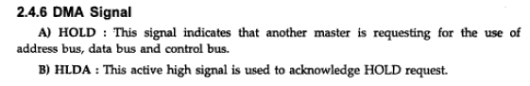

Slide 27
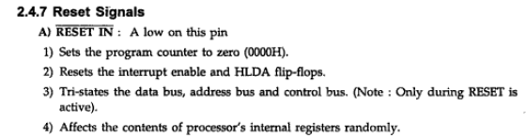
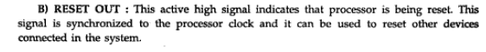

Slide 28
8085 System Bus
Typical system uses a number of busses, collection of wires, which transmit binary numbers, one bit per wire. A typical microprocessor communicates with memory and other devices (input and output) using three busses:
Address Bus,
Data Bus and
Control Bus.

Slide 29
Address Bus
One wire for each bit, therefore 16 bits = 16 wires. Binary number carried alerts memory to ‘open’ the designated box.
Data (binary) can then be put in or taken out.The Address Bus consists of 16 wires, therefore 16 bits. A 16 bit binary number allows 2¹⁶ different numbers, or 32000 different numbers, ie 0000h up to FFFFh.
Because memory consists of boxes, each with a unique address, the size of the address bus determines the size of memory, which can be used.
To communicate with memory the microprocessor sends an address on the address bus, eg 0000000000000011 (3 in decimal), to the memory. The memory the selects box number 3 for reading or writing data.

Slide 30
Data Bus
Data Bus: carries ‘data’, in binary form, between μP and other external units, such as memory. Data bus used to transmit "data", i.e. information, results of arithmetic, etc, between memory and the microprocessor.
Bus is bi-directional. Size of the data bus determines what arithmetic can be done. If only 8 bits wide then largest number is 11111111 (255 in decimal). Therefore, larger number have to be broken down into chunks of 255. This slows microprocessor.
Data Bus also carries instructions from memory to the microprocessor. Size of the bus therefore limits the number of possible instructions to 256,

Slide 31
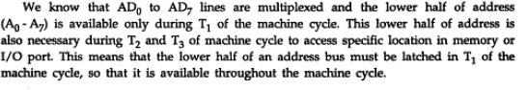
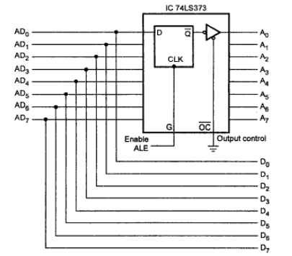
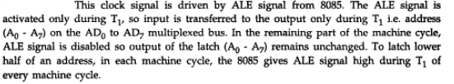

Slide 32
Control Bus
Control Bus are various lines which have specific functions for coordinating and controlling uP operations. Eg: Read/NotWrite line, single binary digit. Control whether memory is being ‘written to’ (data stored in mem) or ‘read from’ (data taken out of mem) 1 = Read, 0 = Write. May also include clock line(s) for timing/synchronising, ‘interrupts’, ‘reset’ etc.

Slide 33
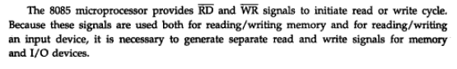
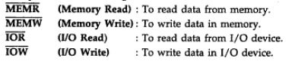
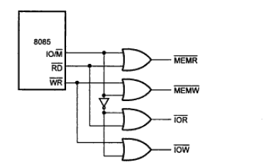

Slide 34
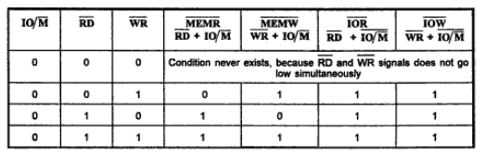
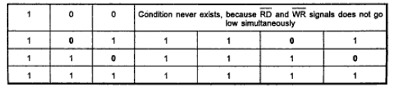

Slide 35
Microprocessors
V/S
Microcontrollers

Slide 36
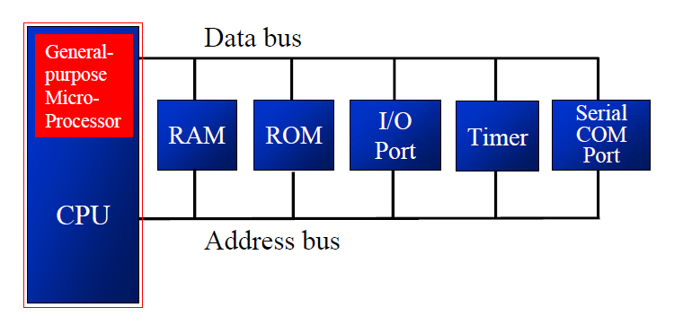
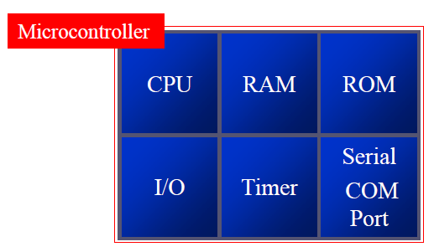

Slide 37
MICROPROCESSORS | MICROCONTROLLERS
contains No RAM, No ROM, No I/O ports. | Microcontroller has CPU, RAM, ROM, I/O ports, Timers, ADC and other peripherals.
Have the advantage of versatility on the amount of RAM, ROM, and I/O ports | The fixed amount of on-chip ROM, RAM, and number of I/O ports makes them ideal for many applications in which cost and space are critical
Must add RAM, ROM, I/O ports, and timers externally to make them functional this Make the system bulkier and much more expensive | In many applications, the space it takes, the power it consumes, and the price per unit are much more critical considerations than the computing power
The prime use of microprocessor is to read data, perform extensive calculations on that data, and store those calculations. | The prime use of microcontroller is to control the operation of a machine using a fixed program that is stored in ROM.

Slide 38
Microprocessor
CPU is stand-alone, RAM, ROM, I/O, timer are separate
designer can decide on the amount of ROM, RAM and I/O ports.
expensive
versatility
general-purpose
High processing power
High power consumption
Instruction sets focus on processing-intensive operations
Typically 32/64 – bit
Typically deep pipeline (5-20 stages)
Microcontroller
CPU, RAM, ROM, I/O and timer are all on a single chip
fixed amount of on-chip ROM, RAM, I/O ports
for applications in which cost, power and space are critical
single-purpose (control-oriented)
Low processing power
Low power consumption
Bit-level operations
Instruction sets focus on control and bit-level operations
Typically 8/16 bit
Typically single-cycle/two-stage pipeline

Slide 39
8085
INSTRUNCTION SET
&
ASSEMBLY LANGUAGE PROGRAMMING

Slide 40
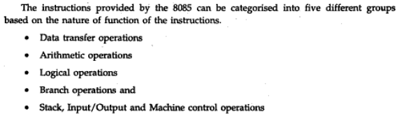

Slide 41
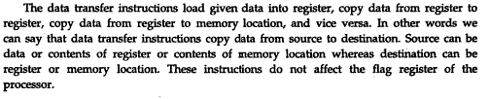
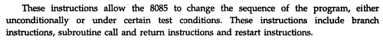
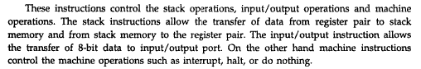

Slide 42
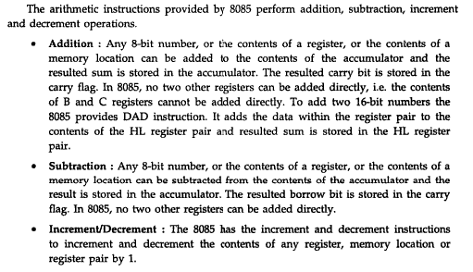

Slide 43
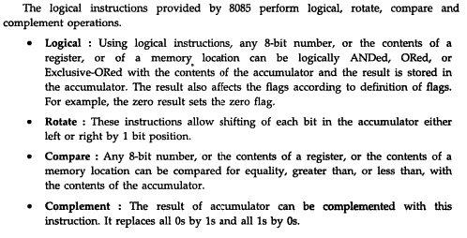

Slide 44
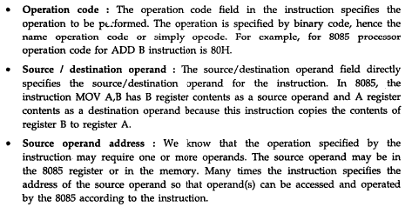

Slide 45
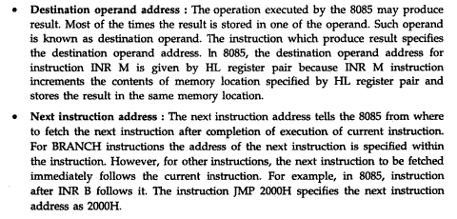

Slide 46
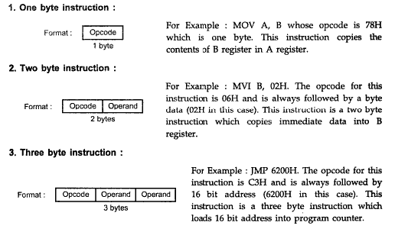

Slide 47
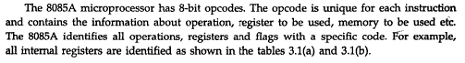
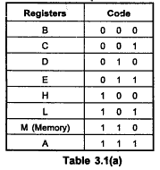
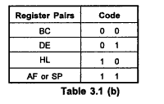
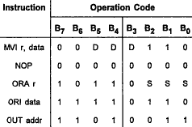

Slide 48
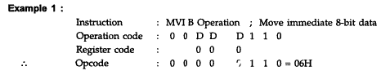
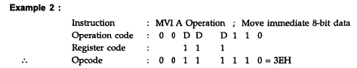

Slide 49
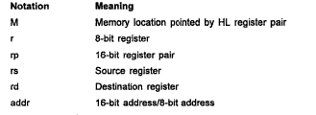

Slide 50
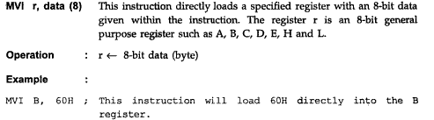
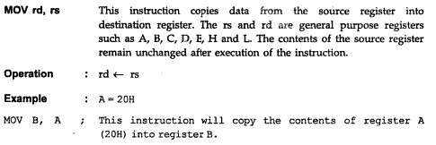

Slide 51
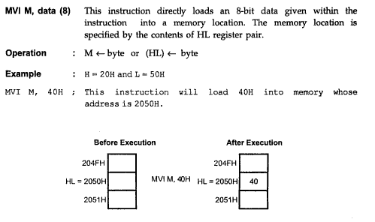

Slide 52
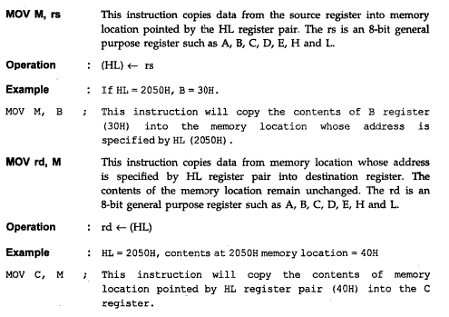

Slide 53



Slide 54


Slide 55



Slide 56


Slide 57




Slide 58


Slide 59


Slide 60



Slide 61


Slide 62




Slide 63



Slide 64


Slide 65





Slide 66


Slide 67



Slide 68


Slide 69




Slide 70




Slide 71



Slide 72


Slide 73


Slide 74


Slide 75


Slide 76


Slide 77



Slide 78


Slide 79



Slide 80


Slide 81



Slide 82




Slide 83



Slide 84


Slide 85




Slide 86


Slide 87


Slide 88



Slide 89



Slide 90



Slide 91



Slide 92


Slide 93


Slide 94


Slide 95



Slide 96


Slide 97



Slide 98


Slide 99


Slide 100
8085
INSTRUCTIONS
TIMING DIAGRAMS

Slide 101



Slide 102

The fetching ,decoding, and execution of a single instruction constitutes an instruction cycle.
Which consist of one to five read or write operations between processor and memory or I/O devices. Each memory or I/O operation requires a particular time period, called machine cycle.
A machine cycle consists of 3 to 6 clock periods/ cycles called as T- states.

Slide 103


Slide 104

In 8085 microprocessor, signals are activated at specific instant for specific time period.
ALE (Address Latch Enable): -
This signal is active high signal. It is activated in the beginning of the T1 state of each machine cycle, except bus idle machine cycle.

Slide 105

A0 – A7 (Lower Byte Address)
The lower byte of address is available on the multiplexed address/data bus (AD0 – AD7) during T1 state of each machine cycle, except bus idle.

Slide 106

D0 – D7 (Data Bus)
The data from memory or I/O device and from microprocessor to memory or I/O device is transferred during T2 – T3 states.
In read machine cycle data will appear on the data bus during the later part of the T2 – state.
Whereas in write cycle data will appear on the data bus at the beginning of T2 – state.

Slide 107



Slide 108



Slide 109


Slide 110
Machine Cycles
The 8085 has seven machine cycles as follows: -
Opcode Fetch
Memory Read
Memory Write
I/O Read
I/O write
Interrupt Acknowledge
Bus Idle

Slide 111

OPCODE FETCH CYCLE: - The first machine cycle of every instruction is opcode fetch cycle, in which 8085 finds the nature of the instruction to be executed. It consists of 4T states to 6T states depending on the instruction.
T1: - 8085 places contents of PC on the address bus. Since we have address on both A8 – A15 & AD0 – AD7, 8085 also activates ALE . Also sends IO/M = 0, S1 = 1 & S0 = 1.
T2: - 8085 sends RD signal low to enable the addressed memory location. The memory device then places the contents of addressed memory location on data bus.
T3: - 8085 loads the data from the data bus in its instruction register and raises RD to high which disables the memory device.
T4: - 8085 decodes the opcode and on the basis of instruction received, it decides whether to enter T5.

Slide 112

Memory Read Cycle: - 8085 executes the memory read cycle to read the contents of R/W memory or Rom. The length of this cycle is 3T states.
T1: - 8085 places the address on the address lines from stack pointer, general purpose register pair or PC and activates ALE. IO/M = 0, S1 = 1, S0 = 0.
T2: - 8085 sends RD signal low to enable the addressed memory location. Memory devices then places the contents of addressed memory location on the data bus.
T3: - 8085 loads the data from the data bus to specified register and raises the RD to high which disables the memory device.

Slide 113

Memory Write Cycle: - 8085 executes the memory write cycle to store the data into the memory or stack. The length of this cycle is 3T states.
T1: - 8085 places the address on the address lines from stack pointer, general purpose register pair or PC and activates ALE. IO/M = 0, S1 = 0, S0 = 1.
T2: - 8085 places data on the data bus and sends WR signal low for writing into the addressed memory location.
T3: - WR signal goes high, which disables the memory device and terminates the write operation.

Slide 114



Slide 115

In response to INTR signal, 8085 executes interrupt acknowledge machine cycle to read an instruction from the external device.
The external device can place any instruction on the data bus in response to INTA. Only RST and CALL save the PC contents before transferring control to the interrupt service routine.
The interrupt acknowledge cycle is similar to the opcode fetch cycle with two exceptions.
The INTA signal is activated instead of RD signal.
The status lines are 111 instead of 011.

Slide 116


Slide 117




Slide 118


Slide 119

TIMING DIAGRAM OF MVI A, 30H which is stored at 2000H

Slide 120


Slide 121

Instruction: -
A000h LXI H, F045h
Coding
A000h 21
A001h 45
A002h F0

Slide 122


Slide 123


Slide 124


Slide 125


Slide 126


Slide 127
Timing diagram for INR M
Fetching the Opcode 34H from the memory 4105H. (OF cycle)
Let the memory address (M) be 4250H. (MR cycle -To read Memory address and data)
Let the content of that memory is 12H. Increment the memory content from 12H to 13H. (MW machine cycle)

Slide 128


Slide 129
Timing diagram for STA 526AH.
STA means Store Accumulator -The contents of the accumulator is stored in the specified address(526A).
The opcode of the STA instruction is said to be 32H. It is fetched from the memory 41FFH -OF machine cycle
Then the lower order memory address is read(6A). - Memory Read Machine Cycle.
Read the higher order memory address (52).- Memory Read Machine Cycle.
The combination of both the addresses are considered and the content from accumulator is written in 526A. - Memory Write Machine Cycle.
Assume the memory address for the instruction and let the content of accumulator is C7H. So, C7H from accumulator is now stored in 526A.

Slide 130


Slide 131
Timing diagram for IN C0H
Fetching the Opcode DBH from the memory 4125H.
Read the port address C0H from 4126H.
Read the content of port C0H and send it to the accumulator.
Let the content of port is 5EH.

Slide 132


Slide 133

ADD M

Slide 134
8085
Programming Techniques
*To be done in LAB
**Chapter 4 of godse

Slide 135
8085
Interrupts

Slide 136
Session Objectives
Need of Interrupts
Explain various types of Interrupts
Classification of RST instructions
Features & operation of8259 interrupt controller
Interfacing of 8259

Slide 137
When a system has one or more I/O devices connected, any of them may demand the service at any time.
The microprocessor can service these devices in one of the two ways.
Polling
Interrupt

Slide 138
Polling
In this μp simply checks each of the I/O devices every so often. During this check the μp tests to see if any device needs servicing.
This is very time consuming and a separate polling program need to be run continuously this wastes processors valuable time and slow up the speed of operation of main program.
The speed of operation decreases with increase in number of I/O devices.
Hence a more desirable method would be the one that allows the μp to be executing its main program and only stop to service I/O device when it is requested.

Slide 139
Types of Interrupts
Interrupts could be classified on the following basis:-
Hardware interrupt & Software Interrupt
Vectored & Non-Vectored
Maskable & Non-maskable

Slide 140
Hardware Interrupt: - Some pins on the 8085 allow the peripheral device to interrupt the main program for I/O operations. When interrupt occurs 8085 completes the instruction it is currently executing and transfers the program control to ISR.
Eg: - TRAP, INTR, RST7.5, RST 6.5 & RST 5.5
Software Interrupt: - In software interrupts, the cause of interrupt is an execution of the instruction. Each of these would send the execution to a predetermined hard-wired memory location.
Eg: - RST 0 – RST 7

Slide 141




Slide 142



Slide 143


Slide 144





Slide 145


Slide 146
8085
MEMORY & I/O
INTERFACING

Slide 147
Memory in a microprocessor system is where information (data and instructions) is kept. It can be classified into two main types:
Main memory (RAM and ROM)
Storage memory (Disks , CD ROMs, etc.)
The simple view of RAM is that it is made up of registers that are made up of flip-flops (or memory elements). The number of flip-flops in a “memory register” determines the size of the memory word.
ROM on the other hand uses diodes instead of the flip-flops to permanently hold the information.

Slide 148
Accessing Information in Memory
For the microprocessor to access (Read or Write) information in memory (RAM or ROM), it needs to do the following:
Select the right memory chip (using part of the address bus).
Identify the memory location (using the rest of the address bus).
Access the data (using the data bus).

Slide 149



Slide 150



Slide 151


Slide 152



Slide 153


Slide 154


Slide 155



Slide 156



Slide 157


Slide 158


Slide 159



Slide 160


Slide 161



Slide 162


Slide 163



Slide 164


Slide 165


Slide 166
8085
I/O
INTERFACING

Slide 167


Slide 168



Slide 169






Slide 170



Slide 171



Slide 172




Slide 173



Slide 174




Slide 175



Slide 176



Slide 177




Slide 178


Slide 179


Slide 180



Slide 181



Slide 182



Slide 183


Slide 184



Slide 185


Slide 186



Slide 187



Slide 188



Slide 189
8085
INTERFACING

Slide 190
Various ICs interfaced to 8085 system
8251 USART
8254 programmable interval timer
8255 PPI (Programmable Peripheral Interface)
8259 Interrupt Controller
8279 Keyboard/Display interface.

Slide 191
8255
Programmable Peripheral
Interface

Slide 192



Slide 193



Slide 194


Slide 195


Slide 196


Slide 197


Slide 198



Slide 199



Slide 200


Control Word for BSR mode: -

Slide 201



Slide 202


Slide 203



Slide 204


Slide 205
In this mode input or output data transfer is controlled by handshaking signals.
Handshaking signals are used to transfer data between devices whose data transfer speeds are not same. Eg: - computer can send data to the printer with larger speed but printer can’t accept data and print data with this rate. So computer has to send data with the speed with which printer can accept.
Hand shaking signals are used to tell computer whether printer is ready to accept the data or not. If printer is ready to accept the data then after sending data on data bus, computer uses another handshaking signal to tell printer that valid data is available on the data bus.

Slide 206



Slide 207



Slide 208

Control Word for I/O mode: -

Slide 209



Slide 210




Slide 211
8253/54
programmable interval timer

Slide 212


Slide 213



Slide 214





DCR C & JNZ BACK execute number of times equal to the count stored in C register.
There are two values specified for the number of T states for JNZ.
Smaller value is applied when the condition is not met & the larger value applied when the condition is met.

Slide 215

Find the Maximum delay possible for 8 bit count?

Slide 216






Slide 217


Slide 218




Slide 219




Slide 220
The 8253/54 solves one of most common problem in any microcomputer system, the generation of accurate time delays under software control.
Instead of setting up timing loops in system software, the programmer configures the 8253/54 to match his requirements, initializes one of the counters of the 8253/54 with the desired quantity, then upon command the 8253/54 will count out the delay and interrupt the CPU when it has completed its tasks.
The 8253/54 includes three identical 16 bit counters that can operate independently.
To operate a counter, a 16-bit count is loaded in its register and, on command, it begins to decrement the count until it reaches 0. At the end of the count, it generates a pulse that can be used to interrupt the CPU.

Slide 221
Features
Three independent 16-bit down counters.
8254 can handle inputs from 0 to 10 where as 8253 can operate upto 2.6 MHz.
Three counters are identical presettable, and can be programmed for either binary or BCD count.
Counter can be programmed in six different modes.
Compatible with all Intel and most other microprocessors.
8254 has powerful command called READ BACK command which allows the user to check the count value, programmed mode and current mode and current status of the counter.

Slide 222


Slide 223

Block Diagram

Slide 224


Data Bus Buffer :
This tri-state, bi-directional, 8-bit buffer is used to interface the 8253/54 to the system data bus. The Data bus buffer has three basic functions.
Programming the modes of 8253/54.
Loading the count registers.
Reading the count values.

Slide 225
Control Word Register : This register is accessed when lines A0 and A1 are at logic 1. It is used to write a command word which specifies the counter to be used (binary or BCD), its mode, and either a read or write operation.
Counters : These three functional blocks are identical in operation. Each counter consists of a single, 16 bit, pre-settable, down counter. The counter can operate in either binary or BCD and its input, gate and output are configured by the selection of modes stored in the control word register. The counters are fully independent. The programmer can read the contents of any of the three counters without disturbing the actual count in process.

Slide 226

Operational Description
Each counter of the 8253/54 is individually programmed by writing a control word into the control word register The Fig shows the control word format.

Slide 227
After power-up, the state of the 8254 is undefined. The Mode, count value, and output of all Counters are undefined.
How each Counter operates is determined when it is programmed. Each Counter must be programmed before it can be used. Unused counters need not be Programmed.
Counters are programmed by writing a Control Word and then an initial count.
The Control Words are written into the Control Word Register, which is selected when A1,A0 e 11. The Control Word itself specifies which Counter is being programmed.

Slide 228
Programming the 8254
8254 can be programmed to provide various types of output through write operation or to check the count while counting through read operations.
WRITE Operation :
1. Write a control word into control register.
2. Load the low-order byte of a count in the counter register.
3. Load the high-order byte of count in the counter register.

Slide 229
READ Operation : In some applications, especially in event counters, it is necessary to read the value of the count in process. This can be done by three possible methods:
Simple Read : It involves reading a count after stopping the counter by controlling the gate input or the clock input of the selected counter, and two I/O read operations are performed by the CPU. The first I/O operation reads the low-order byte, and the second I/O operation reads the high order byte.
Counter Latch Command : In the second method, an appropriate control word is written into the control register to latch a count in the output latch, and two I/O read operations are performed by the CPU. The first I/O operation reads the low-order byte, and the second I/O operation reads the high order byte.

Slide 230

3. Read-Back Command (Available only for 8254) : The third method uses the Read-Back command. This command allows the user to check the count value, programmed Mode, and current status of the OUT pin and Null count flag of the selected counter(s). Fig. shows the format of the control word register for Read-Back command.

Slide 231
MODE OF OPERATION
MODE 0 : Interrupt on terminal count
MODE 1 : Hardware Re-triggerable One-shot
MODE 2 : Rate generator
MODE 3 : Square Wave Rate Generator
MODE 4 : Software Triggered Strobe.
MODE 5 : Hardware triggered strobe (Retriggerable).

Slide 232
Mode 0 : Interrupt on terminal count
The output will be initially low after the mode set operation.
GATE =1 enables counting; GATE =0 disables counting. GATE has no effect on OUT.
After the count is loaded into the selected count Register the output will remain low and the counter is decremented every cycle.
When the terminal count is reached the output will go high and remain high until the selected count is reloaded. This high output signal can be used as interrupt.

Slide 233

After the Control Word and initial count are written to a Counter, the initial count will be loaded on the next CLK pulse.
This CLK pulse does not decrement the count, so for an initial count of N, OUT does not go high until N+1 CLK pulses after the initial count is written.

Slide 234

MODE 1: HARDWARE RETRIGGERABLE ONE-SHOT
The output will be initially high. The output will go low on the CLK pulse following the rising edge at the gate input.
The output will go high on the terminal count and remain high until the next rising edge at the gate input.

Slide 235


The one shot is re-triggerable, hence the output will remain low for the full count after any rising edge of the gate input.
If the counter is loaded during one shot pulse, the current one shot is not affected unless the counter is retriggered. If retriggered, the counter is loaded with the new count and the one-shot pulse continues until the new count expires.

Slide 236

MODE 2 : Rate generator
It is used to generate a pulse equal to the clock period at a given interval. When a count is loaded , the OUT stays high until the count reaches 1, and then the out goes low for one clock period. The count is reloaded automatically and the pulse is generated continuously.

Slide 237

MODE 3 : Square Wave Rate Generator
Initially output is high. For even count, counter is decremented by 2 on the falling edge of each clock pulse. When the counter reaches terminal count, the state of the output is changed and the counter is reloaded with the full count and the whole process is repeated.
If the count is odd and the output is high the first clock pulse (after the count is loaded) decrements the count by 1. Subsequent clock pulses decrement the clock by 2. After timeout, the output goes low and the full count is reloaded.

Slide 238

MODE 4 : Software Triggered Strobe.
OUT will be initially high. When the initial count expires, OUT will go low for one CLK pulse and then go high again. The counting sequence is ``triggered'‘ by writing the initial count.

Slide 239

MODE 5: HARDWARE TRIGGERED STROBE (RETRIGGERABLE)
OUT will initially be high. Counting is triggered by a rising edge of GATE. When the initial count has expired, OUT will go low for one CLK pulse and then go high again.
After writing the Control Word and initial count, the counter will not be loaded until the CLK pulse after a trigger. This CLK pulse does not decrement the count, so for an initial count of N, OUT does not strobe low until N + 1 CLK pulses after a trigger.

Slide 240

Example 1: Write a program to initialize counter 2 in mode 0 with a count of C030H.
Assume address for control register = 0BH, counter 0 = 08H, counter 1 = 09H and counter 2 = 0AH.
Source Program
MVI A,B0H
OUT 0BH ; Loads control word (B0H) in the control register.
MVI A,30H
OUT 0AH ; Loads lower byte of (30H)the count.
MVI A,C0H ; Loads higher byte (C0H) of the count.
OUT 0AH

Slide 241
8259
Interrupt controller

Slide 242
In 8085 microprocessor we get only 5 hardware interrupt inputs.
For application where we have multiple interrupt sources more than 5, then we need external device called a priority Interrupt Controller.
By connecting such device we can increase the interrupt handling capacity of the microprocessor.
8259 is commonly used PIC, designed for use with INTR & INTA.

Slide 243
Features of 8259
It can manage 8 priority interrupts. This is equivalent to providing 8 interrupt pins on the processor in place of INTR pin.
It is possible to locate vector table for these additional interrupts anywhere in the memory map.
By cascading nine 8259 it is possible to get 64 priority interrupts.
Individual interrupts could be masked by interrupt mask register.
8259 can be programmed as either level triggered or edge triggered.

Slide 244


Slide 245
INTERRUPT REQUEST REGISTER (IRR) AND IN-SERVICE REGISTER (ISR): - The interrupts at the IR input lines are handled by two registers in cascade, the Interrupt Request Register (IRR) and the In-Service (ISR). The IRR is used to store all the interrupt levels which are requesting service; and the ISR is used to store all the interrupt levels which are being serviced.
PRIORITY RESOLVER: - This logic block determines the priorities of the bits set in the IRR. The highest priority is selected and strobed into the corresponding bit of the ISR during INTA pulse.
INTERRUPT MASK REGISTER (IMR): - The IMR stores the bits which mask the interrupt lines to be masked. The IMR operates on the IRR. Masking of a higher priority input will not affect the interrupt request lines of lower quality.

Slide 246
DATA BUS BUFFER : -This 3-state, bidirectional 8-bit buffer is used to interface the 8259A to the system Data Bus. Control words and status information are transferred through the Data Bus Buffer.
READ/WRITE CONTROL LOGIC: - The function of this block is to accept Output commands from the CPU. It contains the Initialization Command Word (ICW) registers and Operation Command Word (OCW) registers which store the various control formats for device operation. This function block also allows the status of the 8259A to be transferred onto the Data Bus.

Slide 247
THE CASCADE BUFFER/COMPARATOR : - This function block stores and compares the IDs of all 8259A's used in the system. The associated three I/O pins (CAS0-2) are outputs when the 8259A is used as a master and are inputs when the 8259A is used as a slave. As a master, the 8259A sends the ID of the interrupting slave device onto the CAS0±2 lines. The slave thus selected will send its preprogrammed subroutine address onto the Data Bus during the next one or two consecutive INTA pulses.

Slide 248
INTERRUPT SEQUENCE
The events occur as follows in an MCS-80/85 system:
One or more of the INTERRUPT REQUEST lines (IR7±0) are raised high, setting the corresponding IRR bit(s).
The 8259A evaluates these requests, The priority resolver checks three registers: IRR for interrupt requests, the IMR for masking bits, & the ISR for the interrupt request being served, it resolves the priority and sends an INT to the CPU, if appropriate.
The CPU acknowledges the INT and responds with an INTA pulse.

Slide 249
Upon receiving an INTA from the CPU group, the highest priority ISR bit is set, and the corresponding IRR bit is reset. The 8259A will also release a CALL instruction code (11001101) onto the 8-bit Data Bus through its D7±0 pins.
This CALL instruction will initiate two more INTA pulses to be sent to the 8259A from the CPU group.
These two INTA pulses allow the 8259A to release its preprogrammed subroutine address onto the Data Bus. The lower 8-bit address is released at the first INTA pulse and the higher 8-bit address is released at the second INTA pulse.

Slide 250
PROGRAMMING THE 8259A
The 8259A accepts two types of command words generated by the CPU:
Initialization Command Words (ICWs): Before normal operation can begin, each 8259A in the system must be brought to a starting point by a sequence of 2 to 4 bytes timed by WR pulses.
Operation Command Words (OCWs): These are the command words which command the 8259A to operate in various interrupt modes. These modes are:
a. Fully nested mode
b. Rotating priority mode
c. Special mask mode
d. Polled mode
The OCWs can be written into the 8259A anytime after initialization.

Slide 251
PRIORITY MODES OF OPERATION
Fully Nested Mode (FNM)
Rotating Priority Mode
Special Mask Mode
Poll Mode

Slide 252
Fully Nested Mode
This mode is entered after initialization so it is called as default mode. The interrupt requests are ordered in priority from 0 through 7 (0 highest).
When an interrupt is acknowledged the highest priority request is determined and its vector placed on the bus.
Additionally, a bit of the Interrupt Service register (ISO-7) is set. This bit remains set until the microprocessor issues an End of Interrupt (EOI) command immediately before returning from the service routine, or if AEOI (Automatic End of Interrupt) bit is set, until the trailing edge of the last INTA.
While the IS bit is set, all further interrupts of the same or lower priority are inhibited, while higher levels will generate an interrupt.

Slide 253
End of interrupt (EOI): -
The ISR bit can be reset by an end of interrupt command issued by the MPU, usually just before exiting from the interrupt routine.
There are two forms of EOI command: Specific and Non-Specific. When the 8259A is operated in modes which preserve the fully nested structure, it can determine which IS bit to reset on EOI.
When a Non- Specific EOI command is issued the 8259A will automatically reset the highest IS bit of those that are set, since in the fully nested mode the highest IS level was necessarily the last level acknowledged and serviced.
Automatic End of Interrupt (AEOI) Mode : -
In this mode the 8259A will automatically perform a non-specific EOI operation at the trailing edge of the last interrupt acknowledge pulse.
The AEOI mode can only be used in a master 8259A and not a slave.

Slide 254


Rotating Priority mode: -
In some applications there are a number of interrupting devices of equal priority. In this mode a device, after being serviced, receives the lowest priority, so a device requesting an interrupt will have to wait, in the worst case until each of 7 other devices are serviced at most once .

Slide 255


There are two ways to accomplish Automatic Rotation

Slide 256
Special Mask Mode
Each Interrupt Request input can be masked individually by the Interrupt Mask Register (IMR) programmed through OCW1. Each bit in the IMR masks one interrupt channel if it is set (1). For example Bit 0 masks IR0, Bit 1 masks IR1 and so forth.
Some applications may require an interrupt service routine to dynamically alter the system priority structure during its execution under software control.
For example, the routine may wish to inhibit lower priority requests for a portion of its execution but enable some of them for another portion.

Slide 257

Poll Mode

Slide 258




Slide 259


Slide 260




Slide 261




Slide 262



Slide 263


Slide 264




Slide 265




Slide 266





Slide 267



Slide 268


Slide 269

It has eight bidirectional data lines supported by three handshake signals and five general purpose interface management lines.
The data lines are used to transfer data, addresses, commands and status bytes among as many as 8 to 10 instruments.
Below table shows the format for combination command address codes that a controller can send to talker and listeners.
Bit 8 is don’t care, bit 7 & 6 specify which command is being sent, and bit 1 to 5 gives the address of talker or listener to which command is to be sent.

Slide 270


Slide 271


Slide 272

Centronics Interface

Slide 273
A parallel port is a type of interface found on computers (personal and otherwise) for connecting peripherals. In computing, a parallel port is a parallel communication physical interface. It is also known as a printer port or Centronics port.
It was a de facto industry standard for many years, and was finally standardized as IEEE 1284 in the late 1990s, which defined a bi-directional version of the port.
Today, the parallel port interface is seeing decreasing use because of the rise of Universal Serial Bus (USB) and FireWire (IEEE 1394) devices, along with network printing using Ethernet.
The parallel port interface was originally known as the LPT port (Line Print Terminal, Local Print Terminal, or Line Printer) on IBM PC-compatible computers.

Slide 274
8251
USART

Slide 275

The 8251 is a USART (Universal Synchronous Asynchronous Receiver Transmitter) for serial data communication. As a peripheral device of a microcomputer system, the 8251 receives parallel data from the CPU and transmits serial data after conversion. This device also receives serial data from the outside and transmits parallel data to the CPU after conversion.

Slide 276


Slide 277


Slide 278


Slide 279
Pin Description
D 0 to D 7 (l/O terminal) : - This is bidirectional data bus which receive control words and transmits data from the CPU and sends status words and received data to CPU.
RESET (Input terminal): - A "High" on this input forces the 8251 into "reset status." The device waits for the writing of "mode instruction." The min. reset width is six clock inputs during the operating status of CLK.
CLK (Input terminal): -CLK signal is used to generate internal device timing. CLK signal is independent of RXC or TXC. However, the frequency of CLK must be greater than 30 times the RXC and TXC at Synchronous mode and Asynchronous "x1" mode, and must be greater than 5 times at Asynchronous "x16" and "x64" mode.

Slide 280
WR (Input terminal): - This is the "active low" input terminal which receives a signal for writing transmit data and control words from the CPU into the 8251.
RD (Input terminal): - This is the "active low" input terminal which receives a signal for reading receive data and status words from the 8251.
C/D (Input terminal): - This is an input terminal which receives a signal for selecting data or command words and status words when the 8251 is accessed by the CPU. If C/D = low, data will be accessed. If C/D = high, command word or status word will be accessed.
CS (Input terminal) : - This is the "active low" input terminal which selects the 8251 at low level when the CPU accesses.

Slide 281
TXD (output terminal): - This is an output terminal for transmitting data from which serial-converted data is sent out. The device is in "mark status" (high level) after resetting or during a status when transmit is disabled. It is also possible to set the device in "break status" (low level) by a command.
TXRDY (output terminal): - This is an output terminal which indicates that the 8251is ready to accept a transmitted data character. But the terminal is always at low level if CTS = high or the device was set in "TX disable status" by a command.
TXEMPTY (Output terminal): - This is an output terminal which indicates that the 8251 has transmitted all the characters and had no data character. In "synchronous mode," the terminal is at high level, if transmit data characters are no longer remaining and sync characters are automatically transmitted.

Slide 282
TXC (Input terminal) : - This is a clock input signal which determines the transfer speed of transmitted data. In "synchronous mode," the baud rate will be the same as the frequency of TXC. In "asynchronous mode", it is possible to select the baud rate factor by mode instruction. It can be 1, 1/16 or 1/64 the TXC. The falling edge of TXC sifts the serial data out of the 8251.
RXD (input terminal) : - This is a terminal which receives serial data.
RXRDY (Output terminal): - This is a terminal which indicates that the 8251 contains a character that is ready to READ. If the CPU reads a data character, RXRDY will be reset by the leading edge of RD signal. Unless the CPU reads a data character before the next one is received completely, the preceding data will be lost. In such a case, an overrun error flag status word will be set.

Slide 283
RXC (Input terminal) : - This is a clock input signal which determines the transfer speed of received data. In "synchronous mode," the baud rate is the same as the frequency of RXC. In "asynchronous mode," it is possible to select the baud rate factor by mode instruction. It can be 1, 1/16, 1/64 the RXC.
SYNDET/BD (Input or output terminal): - This is a terminal whose function changes according to mode. In "internal synchronous mode." this terminal is at high level, if sync characters are received and synchronized. If a status word is read, the terminal will be reset. In "external synchronous mode, "this is an input terminal.
A "High" on this input forces the 8251 to start receiving data characters. In "asynchronous mode," this is an output terminal which generates "high level" output upon the detection of a "break" character if receiver data contains a "low-level" space between the stop bits of two continuous characters. The terminal will be reset, if RXD is at high level. After Reset is active, the terminal will be output at low level.

Slide 284
DSR (Input terminal): - This is an input port for MODEM interface. The input status of the terminal can be recognized by the CPU reading status words.
DTR (Output terminal): - This is an output port for MODEM interface. It is possible to set the status of DTR by a command.
CTS (Input terminal): - This is an input terminal for MODEM interface which is used for controlling a transmit circuit. The terminal controls data transmission if the device is set in "TX Enable" status by a command. Data is transmittable if the terminal is at low level.
RTS (Output terminal): - This is an output port for MODEM interface. It is possible to set the status RTS by a command.

Slide 285
Control Words
There are two types of control word.
1. Mode instruction (setting of function)
2. Command (setting of operation)
1) Mode Instruction: - Mode instruction is used for setting the function of the 8251. Mode instruction will be in "wait for write" at either internal reset or external reset. That is, the writing of a control word after resetting will be recognized as a "mode instruction."
Items set by mode instruction are as follows:
Synchronous/asynchronous mode
Stop bit length (asynchronous mode)
Character length
Parity bit
Baud rate factor (asynchronous mode)
Internal/external synchronization (synchronous mode)
Number of synchronous characters (Synchronous mode)

Slide 286


Slide 287


Slide 288
2) Command
Command is used for setting the operation of the 8251. It is possible to write a command whenever necessary after writing a mode instruction and sync characters.
Items to be set by command are as follows:
• Transmit Enable/Disable
• Receive Enable/Disable
• DTR, RTS Output of data
• Resetting of error flag
• Sending to break characters
• Internal resetting
• Hunt mode (synchronous mode)

Slide 289


Slide 290

Status Word
It is possible to see the internal status of the 8251 by reading a status word.
The bit configuration of status word is shown

Slide 291
8279
Keyboard & Display
Interface

Slide 292


Slide 293
Block Diagram: - It consists of four main sections:
CPU interface and control section
Data buffers
I/O Control
Control & Timing registers
Control & Timing logic
SCAN section
Keyboard section
Return buffers
Keyboard debounce & control
FIFO / Sensor RAM
FIFO / Sensor RAM status
Display section
Display RAM
Display address Registers
Display registers

Slide 295
Operating Modes
Input Modes
Scanned Keyboard
Scanned Sensor Matrix
Strobed Input
Display Modes
Left Entry (Type writer type)
Right Entry (calculator type)

